Slide 1
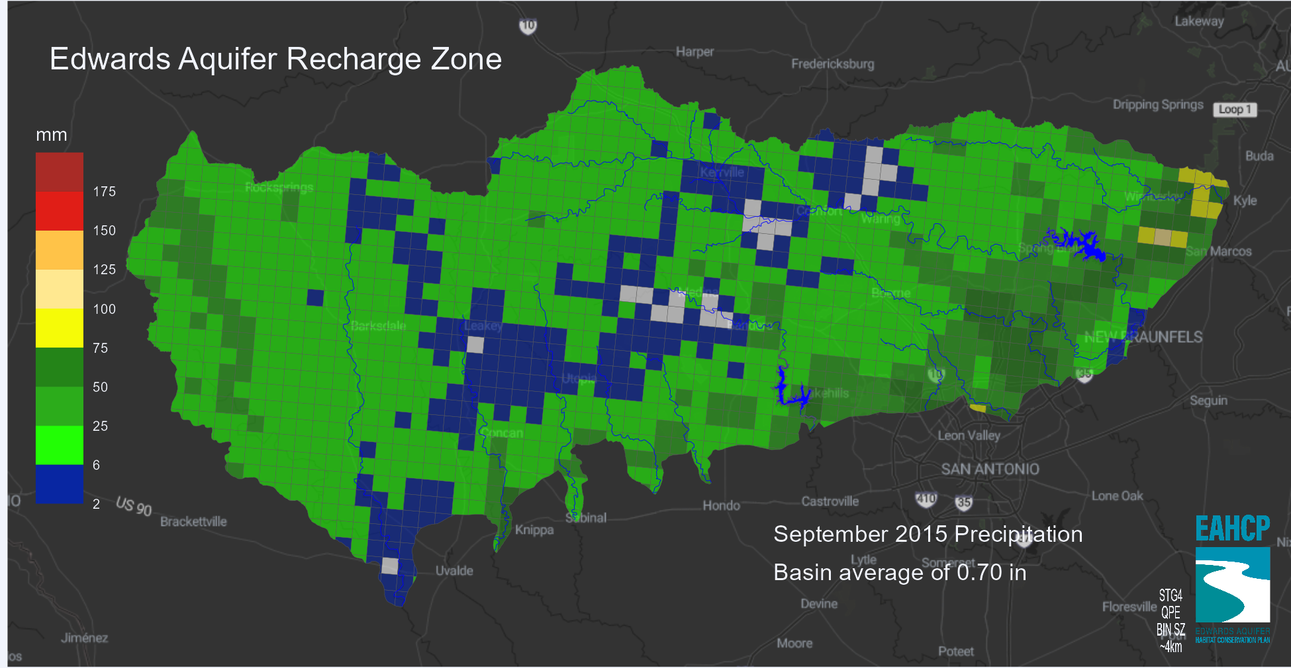
EAA recharge zone whole basin examination.
Fine scale gradient look.
Individual storms to water-years.
Card focuses on linear precip values (whole basin currently)

Slide 2
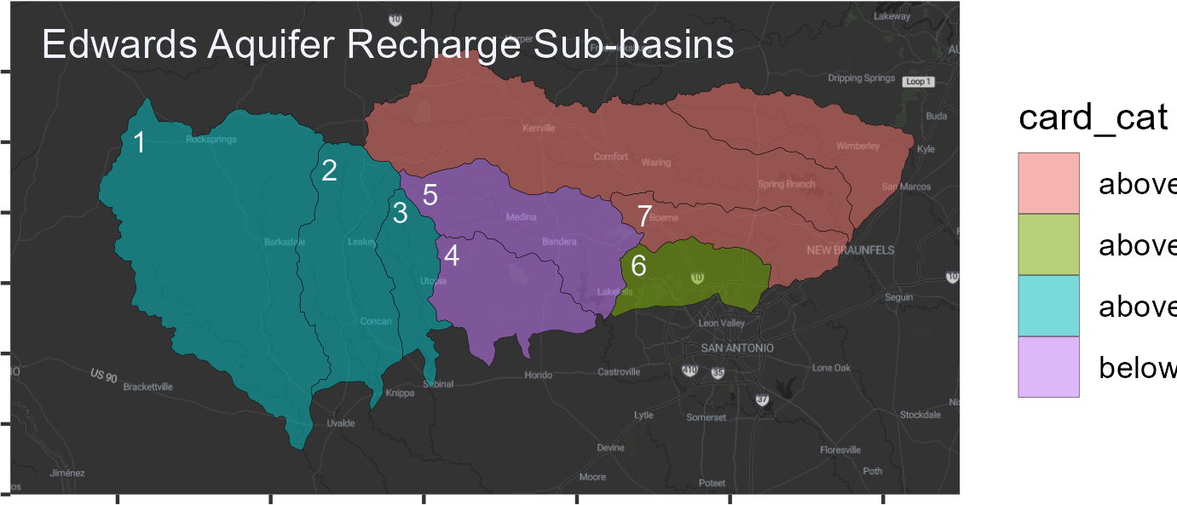
EAA recharge zone sub whole basin examination.
Fine basin scale gradient look.
Individual storms monthly to water-years.
Card color scheme focuses on linear precip values percentiles (whole basin currently)

